Slide 1
YOU: A New Social Network
For ages 13-18
Filip Kolovrat
CIS 1020-037

Slide 2
Introduction
The world we live in is full of media pollution and harmful material. It is an everyday struggle that everyone experiences at one point or another. Whether it is a kid being bullied at school, Facebook or MySpace, or a parent struggling to set their child on the right path to success, there are countless mediums from which children nowadays are forming jaded opinions toward life.
Notes:
Read this paragraph to introduce basis of social network

Slide 3
Intro (continued)
-Books, TV, movies, magazines, and other forms of media affect children everyday.
-Low self-esteem, obesity, poor grades, and drug and alcohol addictions are some problems that teens encounter.
Notes:
Explain some everyday factors that teens face

Slide 4
Statistics
-77% of students are bullied mentally, verbally, or physically.
-More than 40% of children watch 2+ hours of TV each day.
-73% of teens and young adults are a member of at least one social network.
-The most occurring sign of discrimination among obese children is social and societal acceptance. This can lead to poor self-esteem and depression.
-The average American youth spends 1500 hours (that’s over 2 months) per year watching TV.
Notes:
Read these stats

Slide 5
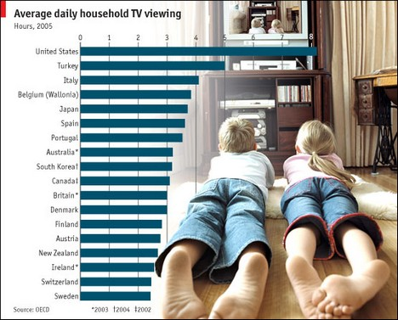
TV in the U.S.
Notes:
Explain graph and stress how more the U.S. averages than other countries.

Slide 6
YOU: A New Social Network Concept
“YOU” is the name of my idea for a new social network. It will take the focus off the amount of friends a user has and focus more on help youth with a variety of things.
Notes:
Briefly introduce “YOU”

Slide 7
What “YOU” is about
“YOU” will put the spotlight on bettering yourself as a person by:
-dedicating a portion of the site to e education (scholarships, homework help, quizzes, etc.)
-self-help tips and links to professionals who can answer questions that teens have.
-MUCH MORE!!!
Notes:
Describe the social network in a little more detail

Slide 8
GET INVOLVED!!!
Join YOU!
Spread the word to your friends and family members!
For some more statistics and info visit:
file://localhost/Volumes/FILIP/A_New_Social_Network.docx

Slide 9
References
CSUN. (2007). Retrieved from Television and Health: http://www.csun.edu/science/health/docs/tv&health.html
Graphics.ms. (2010). Retrieved from Social Networking Statistics: http://www.graphicsms.com/blog/877-social-networking-statistics-2010/
How to Stop Bullying. (2009). Retrieved from Bullying Statistics: http://www.how-to-stop-bullying.com/bullyingstatistics.html
Obesity Action Coalition. (2010). Retrieved from Educational Tools: http://www.obesityaction.org/educationaltools/factsandstats.php

